Slide 1
Lecture 7
Greedy algorithms
Introduction
Change-Making Problem
Prim’s MST algorithm
Kruskal’s MST algorithm
Shortest paths – Dijkstra’s algorithm

Slide 2
greedy-choice
Every two-years-old knows the greedy algorithm.
In order to get what you want,
just start grabbing what looks best.
Surprisingly, many important and practical optimization problems can be solved this way.

Slide 3
Greedy algorithms
  When we have a choice to make, make the one that looks best right now.
  Make a locally optimal choice in hope of getting a globally optimal solution.
globally optimal
locally optimal
locally optimal

Slide 4
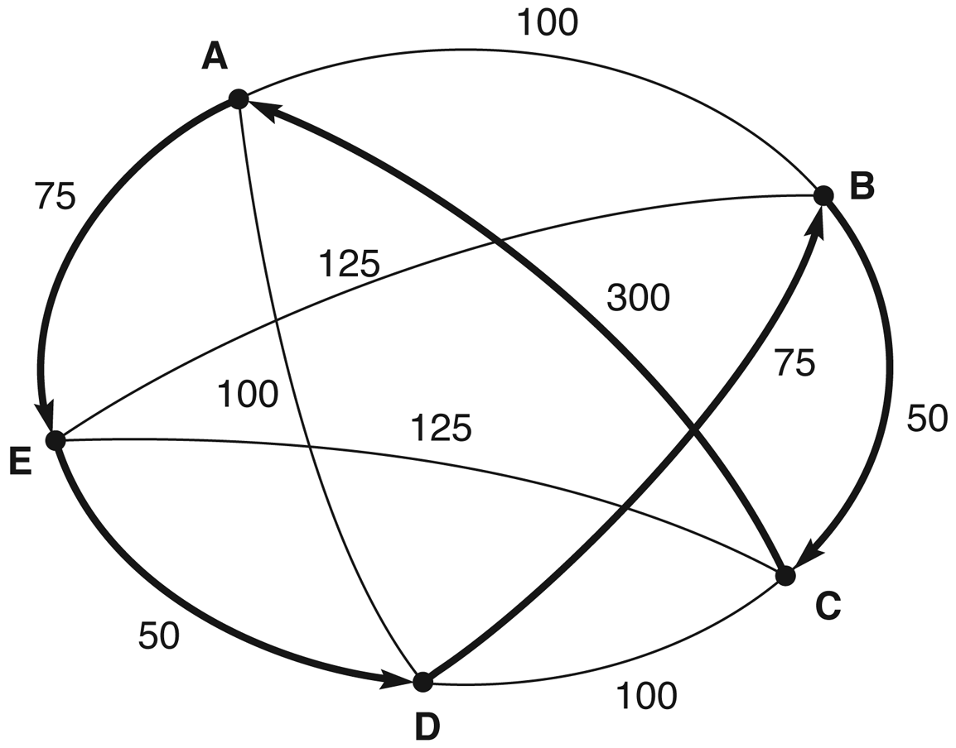
Greedy algorithms
For most problems greedy algorithms do not yield globally optimal solution, but can be useful for fast approximations. E.g greedy nearest neighbor
Greedy Nearest neighbor=
AEDBCA (550)
Optimal Minimal cost path =
ABCDEA (375)
In this course we are mostly interested in the ones that yield globally optimal solutions

Slide 5
Applications of the Greedy Strategy
Optimal solutions -examples:
  change making for “normal” coin denominations
  minimum spanning tree (MST)
  single-source shortest paths
  simple scheduling problems
  Huffman codes
Approximations/heuristics -examples:
  traveling salesman problem (TSP)
  knapsack problem
  others combinatorial optimization problems

Slide 6
Change-Making Problem
Given unlimited amounts of coins of denominations d1 > d2… > d_{m},
give change for amount n with the least number of coins:
Example: d₁ = 25c, d₂ =10c, d₃ = 5c, d₄ = 1c and n = 48c
Greedy solution:
Greedy solution is
optimal for any amount and “normal’’ set of denominations
But may not be optimal for arbitrary coin denominations
<1, 2, 0, 3>
For example, d1 = 25c, d2 = 10c, d3 = 1c, and n = 30c
<1, 0, 5>➔ 6 coins not optimal, the optimal is <0, 3, 0>

Slide 7
Knapsack problem
Fractional knapsack problem
  P
0/1 knapsack problem
  NP-Complete
  Approximation
9-<number>

Slide 8
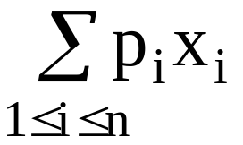
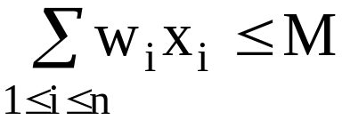
Fractional knapsack problem
n objects, each with a weight w_{i} > 0
a profit p_{i} > 0
capacity of knapsack: M
Maximize
Subject to
0 ≤ x_{i} ≤ 1, 1 ≤ i ≤ n
4 -<number>

Slide 9
The knapsack algorithm
The greedy algorithm:
Step 1: Sort p_{i}/w_{i} into nonincreasing order.
Step 2: Put the objects into the knapsack according
to the sorted sequence as possible as we can.
e. g.
  n = 3, M = 20, (p₁, p₂, p₃) = (25, 24, 15)
  (w₁, w₂, w₃) = (18, 15, 10)
  Sol: p₁/w₁ = 25/18 = 1.32
  p₂/w₂ = 24/15 = 1.6
  p₃/w₃ = 15/10 = 1.5
  Optimal solution: x₁ = 0, x₂ = 1, x₃ = 1/2
4 -<number>

Slide 10
0/1 knapsack problem
Def: n objects, each with a weight w_{i} > 0
a profit p_{i} > 0
capacity of knapsack : M
Maximize ∑p_{i}x_{i}
1≤i≤n
Subject to ∑w_{i}x_{i} ≤ M
1≤i≤n
x_{i} = 0 or 1, 1≤ i ≤n
Decision version :
Given K, ∃ ∑p_{i}x_{i} ≥ K ?
1≤i≤n
Knapsack problem : 0 ≤ x_{i} ≤ 1, 1≤ i ≤n.
3- <number>

Slide 11
Minimum Spanning Tree (MST)
Spanning tree of a connected graph G: a connected acyclic subgraph of G that includes all of G’s vertices
Minimum spanning tree of a weighted, connected graph G: a spanning tree of G of the minimum total weight
Example:
6
c
6
c
c
a
a
a
4
1
4
1
1
2
2
d
d
d
b
3
b
b
3

Slide 12
Prim’s MST algorithm
Start with tree T₁ consisting of one (any) vertex and “grow” tree one vertex at a time to produce MST through a series of expanding subtrees T₁, T₂, …, T_{n}
On each iteration, construct T_{i+1} from T_{i} by adding vertex not in T_{i} that is closest to those already in T_{i} (this is a “greedy” step!)
Stop when all vertices are included

Slide 13
Example
4
c
4
c
4
c
a
a
a
1
1
1
6
6
6
2
2
2
d
d
d
b
3
b
3
b
3
4
c
4
c
a
a
1
1
6
6
2
2
d
d
b
3
b
3

Slide 14
Notes about Prim’s algorithm
It is proved that this construction actually yields an MST (optimal solution)
Efficiency
  O(n²) for weight matrix representation of graph and array implementation of priority queue
  O(m log n) for adjacency lists representation of graph with n vertices and m edges

Slide 15
Another greedy algorithm for MST: Kruskal’s
Sort the edges in nondecreasing order of lengths
“Grow” tree one edge at a time to produce MST through a series of expanding forests F₁, F₂, …, F_{n-1}
On each iteration, add the next edge on the sorted list unless this would create a cycle. (If it would, skip the edge.)

Slide 16
Example
4
c
4
c
4
c
a
a
a
1
1
1
6
6
6
2
2
2
d
d
d
b
3
b
3
b
3
4
c
c
c
a
a
a
1
1
1
6
6
2
2
2
d
d
d
b
3
b
3
b
3

Slide 17
Notes about Kruskal’s algorithm
Algorithm looks easier than Prim’s but is harder to implement (checking for cycles!)
Cycle checking: a cycle is created iff added edge connects vertices in the same connected component
Runs in O(m log m) time, with m = |E|. The time is mostly spent on sorting.

Slide 18
Shortest paths – Dijkstra’s algorithm
Single Source Shortest Paths Problem: Given a weighted connected (directed) graph G, find shortest paths from source vertex s to each of the other vertices
Dijkstra’s algorithm: Similar to Prim’s MST algorithm, with a different way of computing numerical labels: Among vertices not already in the tree, it finds vertex u with the smallest sum d_{v} + w(v,u)
where
v is a vertex for which shortest path has been already found on preceding iterations (such vertices form a tree rooted at s) d_{v} is the length of the shortest path from source s to v
w(v,u) is the length (weight) of edge from v to u

Slide 19
Dijkstra’s algorithm
Let the node at which we are starting be called the initial node. Let the distance of node Y be the distance from the initial node to Y. Dijkstra's algorithm will assign some initial distance values and will try to improve them step by step.
  Assign to every node a distance value. Set it to zero for our initial node and to infinity for all other nodes.
  Mark all nodes as unvisited. Set initial node as current.
  For current node, consider all its unvisited neighbors and calculate their distance (from the initial node). For example, if current node (A) has distance of 6, and an edge connecting it with another node (B) is 2, the distance to B through A will be 6+2=8. If this distance is less than the previously recorded distance (infinity in the beginning, zero for the initial node), then overwrite the distance.

Slide 20
Dijkstra’s algorithm~ cont
  When we are done considering all neighbors of the current node, mark it as visited. A visited node will not be checked ever again; its distance recorded now is final and minimal.
  If all nodes have been visited, finish. Otherwise, set the unvisited node with the smallest distance (from the initial node) as the next "current node" and continue from step 3.

Slide 21
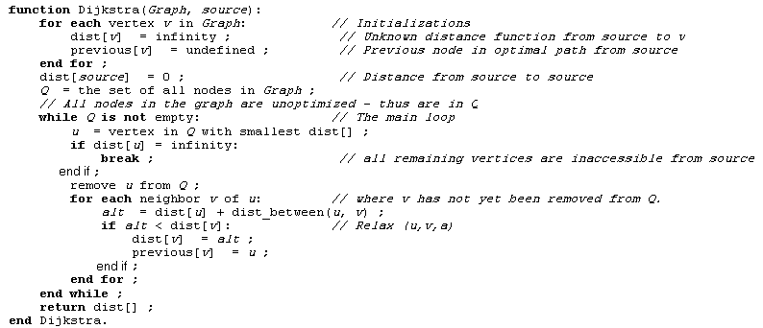
Dijkstra’s algorithm

Slide 22
Example
b
4
c
3
6
7
2
5
4
a
d
d
e
Tree vertices Remaining vertices
a(-,0) b(a,3) c(-,∞) d(a,7) e(-,∞)
4
b
c
3
2
6
5
a
7
d
4
e
b(a,3) c(b,3+4) d(b,3+2) e(-,∞)
b
4
c
3
6
2
5
a
7
d
4
e
d(b,5) c(b,7) e(d,5+4)
b
4
c
3
6
2
5
a
7
d
4
e
c(b,7) e(d,9)
4
b
c
3
6
2
5
a
7
d
4
e
e(d,9)

Slide 23
Notes on Dijkstra’s algorithm
Applicable to both undirected and directed graphs
Efficiency
  O(|V|²) for graphs represented by weight matrix and array implementation of priority queue
  O(|E|log|V|) for graphs represented by adj. lists
Don’t mix up Dijkstra’s algorithm with Prim’s algorithm!

